Slide 1
NEURAL NETWORK ACCELERATION ON GPUS
MNIST Classification Case Study
Presented By:
Ubaida Tariq
Rihab Rabbani
Muhammad Khan

Slide 2

Introduction to MNIST & Neural Networks
MNIST Dataset:
70,000 grayscale images (28×28 pixels)
Handwritten digits (0-9)
Neural Network Structure:
Input Layer: 784 neurons
Hidden Layer: 128 neurons (256 in later versions)
Output Layer: 10 neurons (digits 0-9)
Objective:
Optimize training speed using GPU acceleration

Slide 3
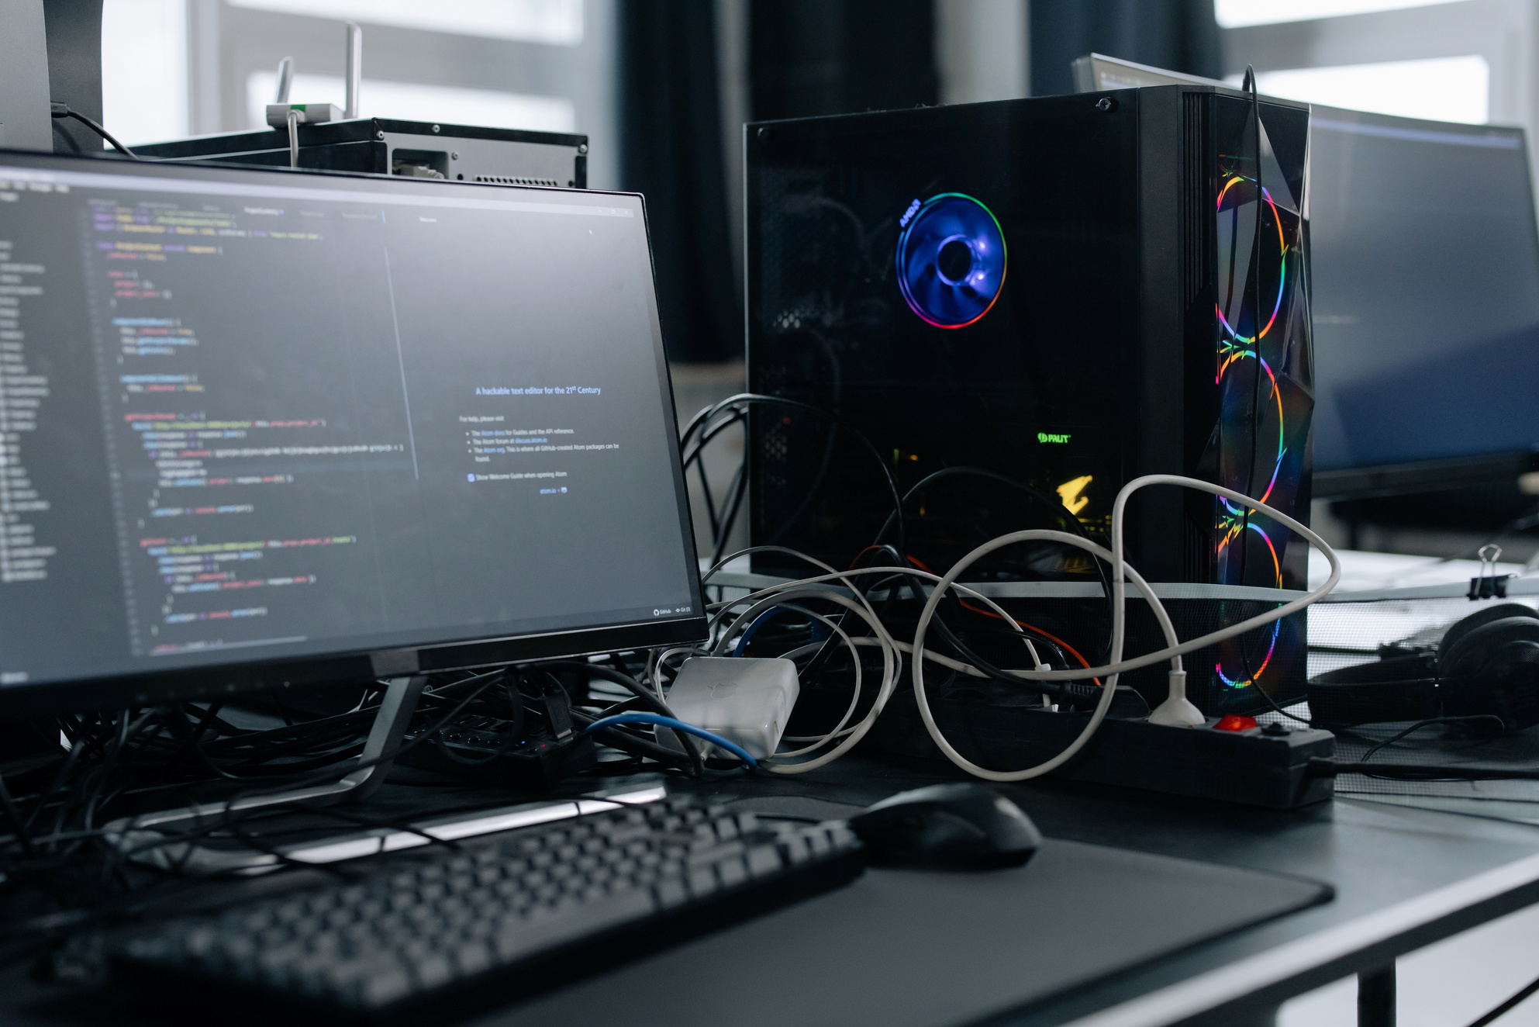
Baseline Implementation (V1 - CPU)
V1 - Sequential CPU Implementation
Key Features:
Fully sequential execution
Basic SGD with backpropagation
ReLU (hidden layer) & Softmax (output)
Performance:
Training Time: 18 seconds
Accuracy: ~93%
Limitations:
No parallelization
Slow matrix operations

Slide 4
Naive GPU Implementation (V2)
V2 - Initial GPU Port
Key Changes:
Parallelized matrix operations
CUDA kernels for forward/backward passes
Basic memory management (host-device transfers)
Performance:
Training Time: 35.23 seconds (slower than V1!)
Why? Excessive memory transfers & poor kernel optimization
Lessons Learned:
Simple GPU port ≠ automatic speedup

Slide 5
Optimized GPU Implementation (V3)
V3 - Optimized GPU Version
Key Optimizations:
Pinned memory for faster transfers
Batch processing (reduced overhead)
Tiled matrix multiplication (TILE_WIDTH=16)
Momentum (0.9) & Weight Decay (0.0001)
Performance:
Training Time: 8.62 seconds (2.09x faster than V1)
V3-accurate: 21.1 sec (full precision)

Slide 6
Tensor Core Implementation (V4 - FP16)
V3 - Optimized GPU Version
Key Features:
FP16 computation (mixed precision)
Tensor Core optimization
Reduced memory footprint
Performance:
Training Time: 4.23 seconds (4.25x faster than V1!)
Accuracy: ~92% (slight drop due to FP16)

Slide 7
OpenACC-Enhanced Implementation (V5)
Key Innovations:
Hybrid Parallelization:
CUDA for neural network ops
OpenACC for data preprocessing
Memory Optimizations:
Unified memory (CUDA + OpenACC)
Pinned memory for faster transfers
Compute Boost:
SIMD vectorization (host-side)
Larger batch size (128 → better throughput)
Performance:
Training Time: 6.11 seconds
Speedup: 2.95x vs V1, 1.42x vs V3
Accuracy: ~93% (maintained full precision)

Slide 8
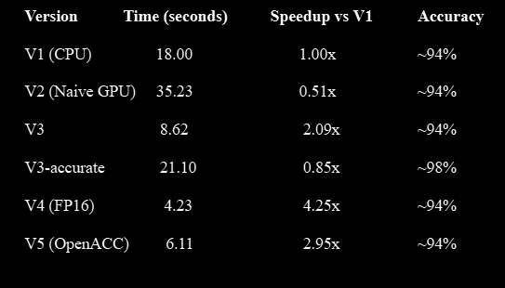
Performance Comparison
Training Time & Speedup
Takeaway:
Proper GPU optimization is crucial
Tensor Cores provide the best speedup

Slide 9

Naive GPU ≠ Faster GPU
Memory transfers & kernel optimization matter
Batch Processing Helps
Reduces overhead of small operations
FP16 & Tensor Cores Boost Speed
But may slightly reduce accuracy
Trade-offs Exist
Speed vs. precision (V3 vs. V3-accurate)
Key Learnings

Slide 10

Conclusion & Future Work
Achievements:
Optimized MNIST classifier from 18s → 4.23s
Learned GPU acceleration techniques
Future Work:
Try CNNs (Convolutional Neural Networks)
Multi-GPU training
More advanced optimizations (e.g., cuDNN)

Slide 11
ANY QUESTIONS?
Slide
10

